Slide 1


Course Code: CSE106
Course Title: Discrete Mathematics
Presentation Topic: Use of Big-$θ$Notation in the Time Complexity Analysis of Algorithms

Slide 2
INTRODUCTION
SUBMITED TO : SUBMITED BY :
Dr. MOHAMMAD SALAH UDDIN MD. ARIFUR RAHMAN RAZU
DEPARTMENT OF CSE ID: 2024-3-60-503

Slide 3
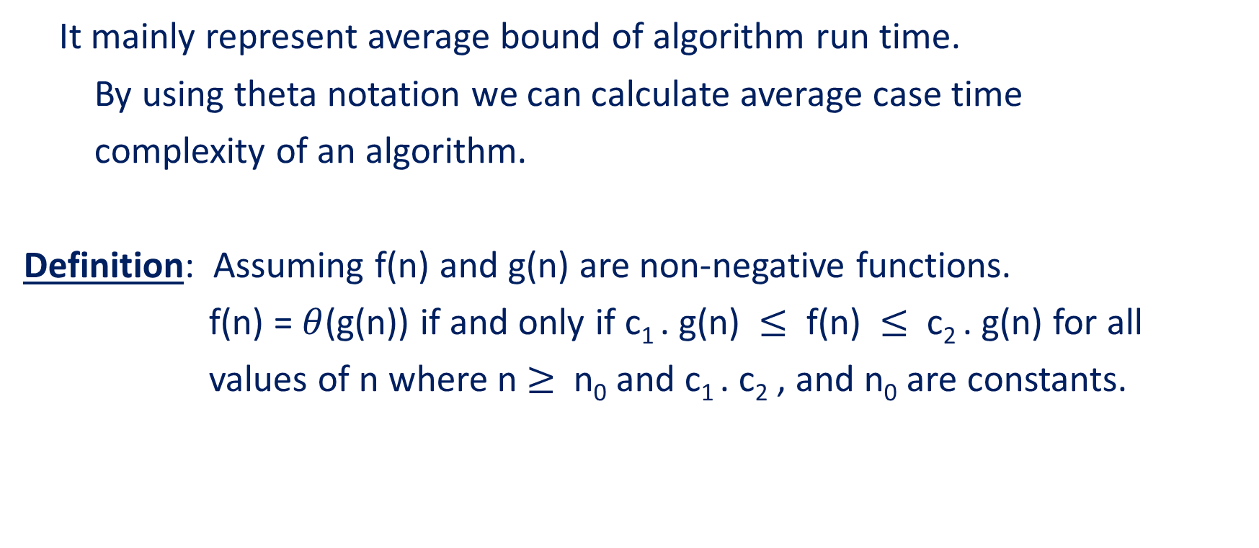

The Big Theta ($θ$) Notation
It mainly represent average bound of algorithm run time.
By using theta notation we can calculate average case time
complexity of an algorithm.
Definition: Assuming f(n) and g(n) are non-negative functions.
f(n) = $θ$(g(n)) if and only if c₁ . g(n) $≤$ f(n) $≤$ c₂ . g(n) for all
values of n where n $≥$ n₀ and c₁ . c₂ , and n₀ are constants.

Slide 4
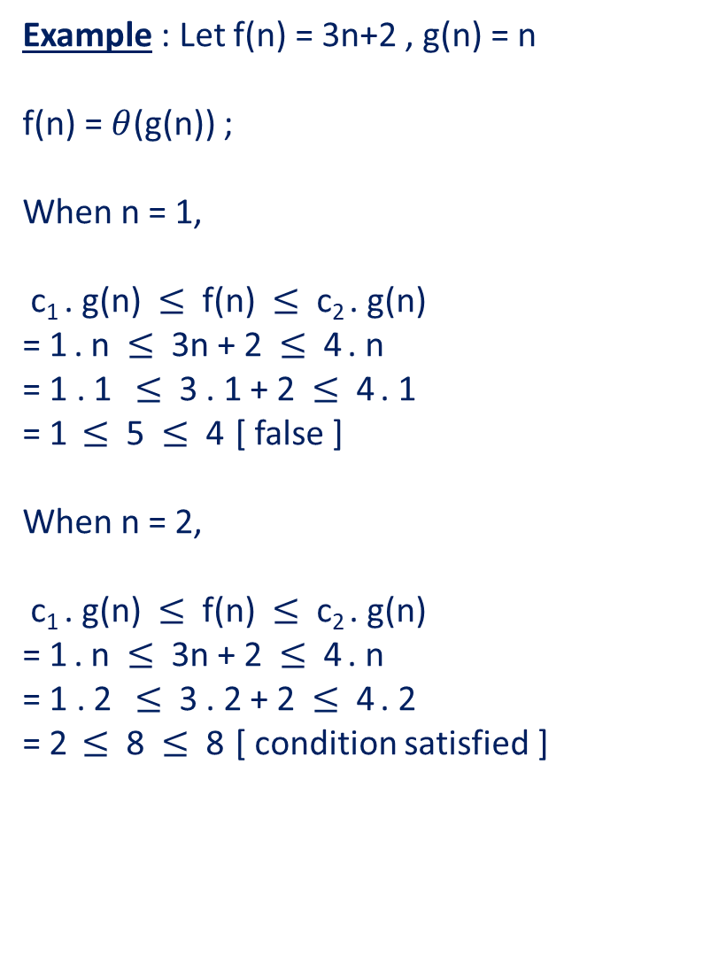
Example : Let f(n) = 3n+2 , g(n) = n
f(n) = $θ$(g(n)) ;
When n = 1,
c₁ . g(n) $≤$ f(n) $≤$ c₂ . g(n)
= 1 . n $≤$ 3n + 2 $≤$ 4 . n
= 1 . 1 $≤$ 3 . 1 + 2 $≤$ 4 . 1
= 1 $≤$ 5 $≤$ 4 [ false ]
When n = 2,
c₁ . g(n) $≤$ f(n) $≤$ c₂ . g(n)
= 1 . n $≤$ 3n + 2 $≤$ 4 . n
= 1 . 2 $≤$ 3 . 2 + 2 $≤$ 4 . 2
= 2 $≤$ 8 $≤$ 8 [ condition satisfied ]

Slide 5
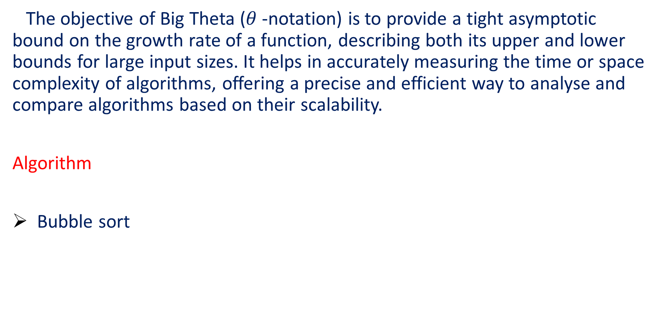
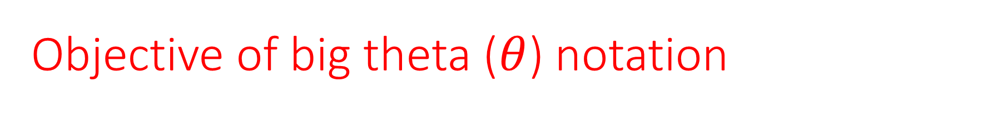
Objective of big theta ($θ$) notation
The objective of Big Theta ($θ$-notation) is to provide a tight asymptotic bound on the growth rate of a function, describing both its upper and lower bounds for large input sizes. It helps in accurately measuring the time or space complexity of algorithms, offering a precise and efficient way to analyse and compare algorithms based on their scalability.
Algorithm
Bubble sort

Slide 6
Bubble Sort
#include <stdio.h>
void main ()
{
int arr[ ] = { 12, -2, -5, 10, 7 } ;
int i, j, temp, size = 5 ;
for( i = 0 ; i < size – 1 ; i++ )
{
for( j = 0 ; j < size – 1 ; j++ )
{
if( arr[j] > arr[ j + 1])
{
temp = arr[j];
arr[j] = arr[ j + 1];
arr[ j + 1] = temp;
}
}
}
printf("\nAfter sorting:\n");
for( i = 0 ; i < size ; i++ )
{
printf("%d ",arr[i]);
}
printf("\n");
}

Slide 7
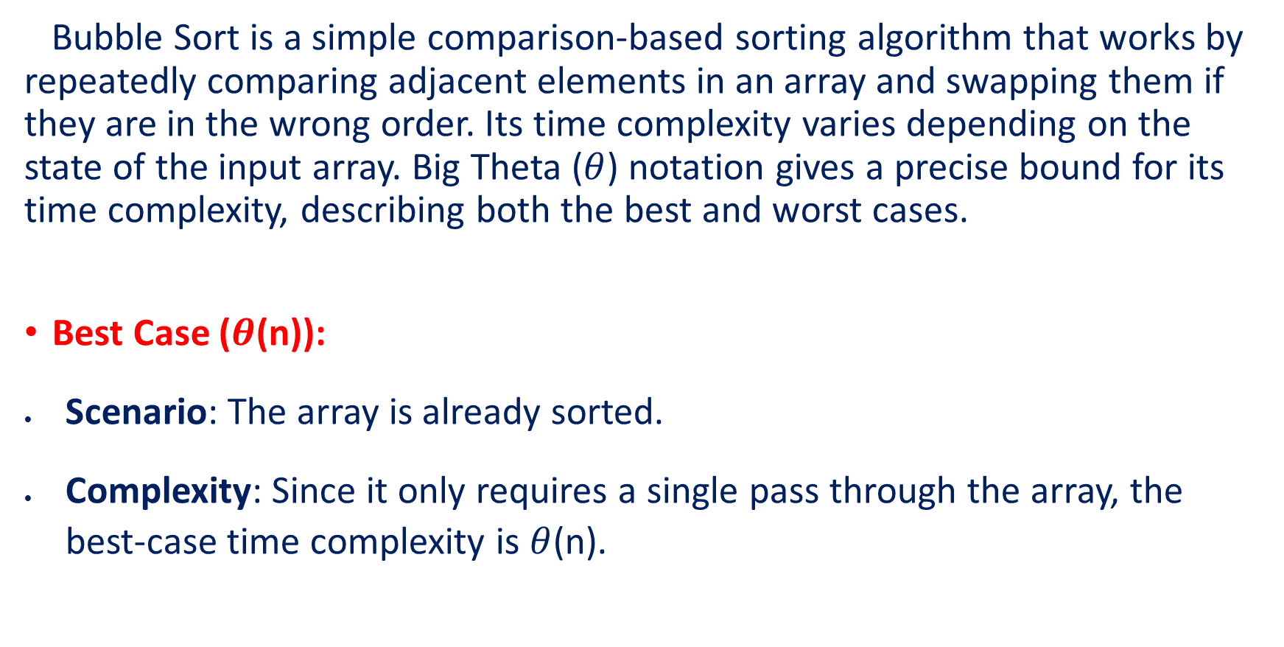
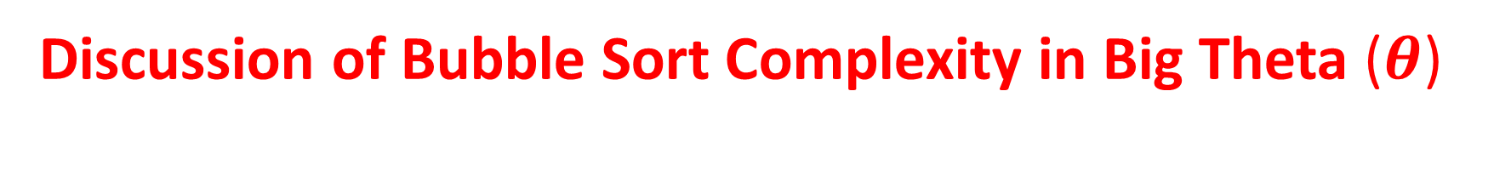
Discussion of Bubble Sort Complexity in Big Theta ($θ$)
Bubble Sort is a simple comparison-based sorting algorithm that works by repeatedly comparing adjacent elements in an array and swapping them if they are in the wrong order. Its time complexity varies depending on the state of the input array. Big Theta ($θ$) notation gives a precise bound for its time complexity, describing both the best and worst cases.
Best Case ($θ$(n)):
Scenario: The array is already sorted.
Complexity: Since it only requires a single pass through the array, the best-case time complexity is $θ$(n).

Slide 8
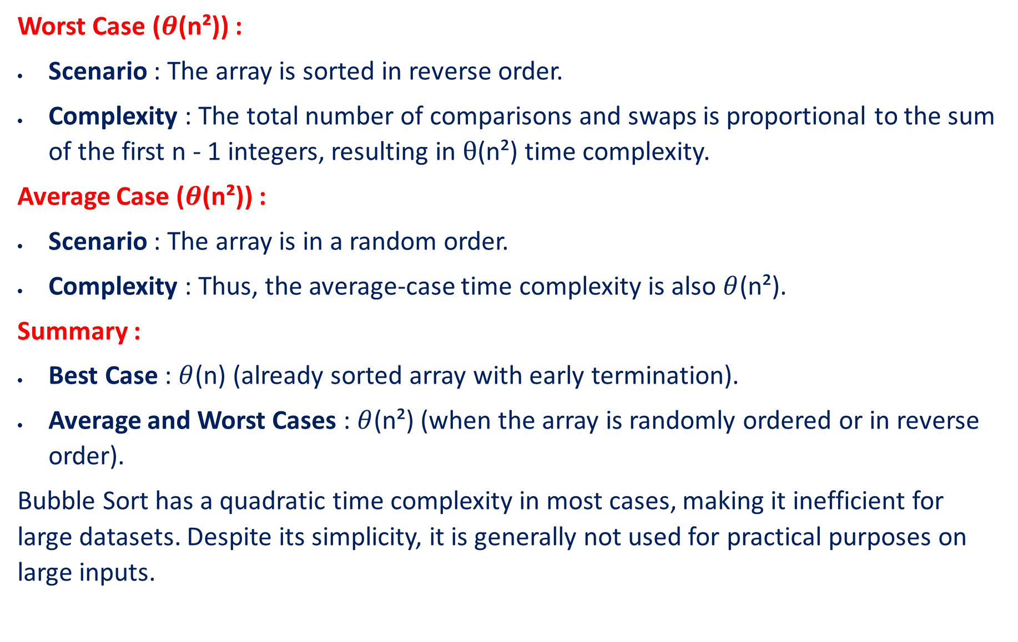
Worst Case ($θ$(n²)) :
Scenario : The array is sorted in reverse order.
Complexity : The total number of comparisons and swaps is proportional to the sum of the first n - 1 integers, resulting in $θ$(n²) time complexity.
Average Case ($θ$(n²)) :
Scenario : The array is in a random order.
Complexity : Thus, the average-case time complexity is also $θ$(n²).
Summary :
Best Case : $θ$(n) (already sorted array with early termination).
Average and Worst Cases : $θ$(n²) (when the array is randomly ordered or in reverse order).
Bubble Sort has a quadratic time complexity in most cases, making it inefficient for large datasets. Despite its simplicity, it is generally not used for practical purposes on large inputs.

Slide 9
Conclusion
Big Theta notation is an essential tool in algorithm analysis because it gives a precise characterization of the time complexity of an algorithm. It helps developers and computer scientists make informed decisions about which algorithms to use based on their efficiency and scalability. By providing a clear understanding of how an algorithm will perform as the input size grows, Big Theta notation plays a critical role in the development of efficient software systems and in the field of computational complexity theory.

